Slide 2
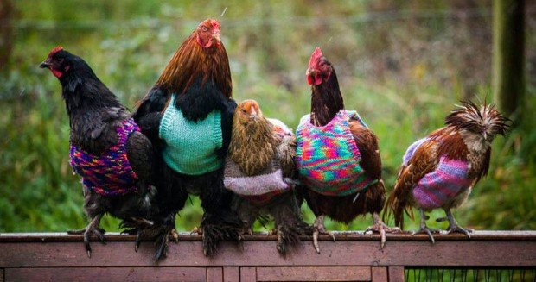
WELCOME
SLE254 Practical 2
(Sexing chickens – Part I)

Slide 3
Pracs 2-4
Week 4 - Prac 2
Pipette practice
DNA extraction
(Blood/ Muscle tissue/ Feather)
Assessment task
1x scientific poster (32%) of the total mark.
Record all your results and any changes in the methods.
Due date: 8pm Friday 20th September.
We will discuss poster requirements in more detail in classes.
Week 6 - Prac 3:
Visualise extracted DNA product on agarose gel and estimate concentration of extracted DNA using the Nanodrop instrument.
Amplify the CHD 1 gene using PCR.
Week 8 - Prac 4:
Visualise PCR product on agarose gel.
Analyse gel to determine the sex of your sample/s.

Slide 4
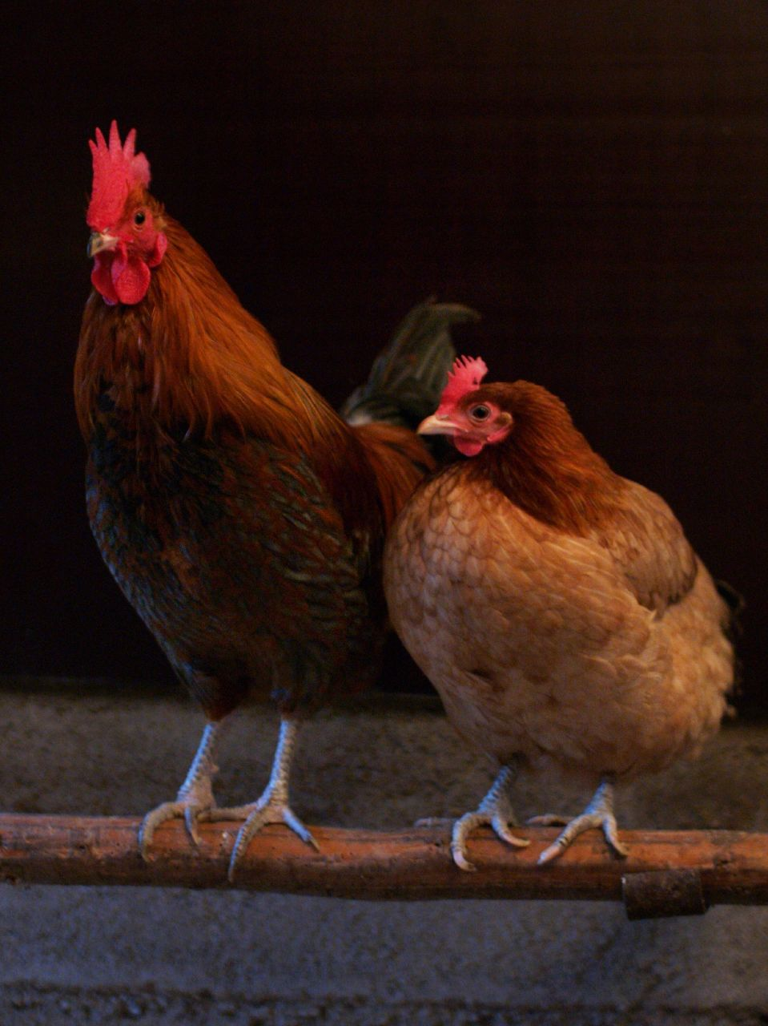
Determining the sex of the domestic chicken (Gallus gallus)
Females and males of sexually dimorphic species can be easily distinguished by differences in their phenotype.

Slide 5
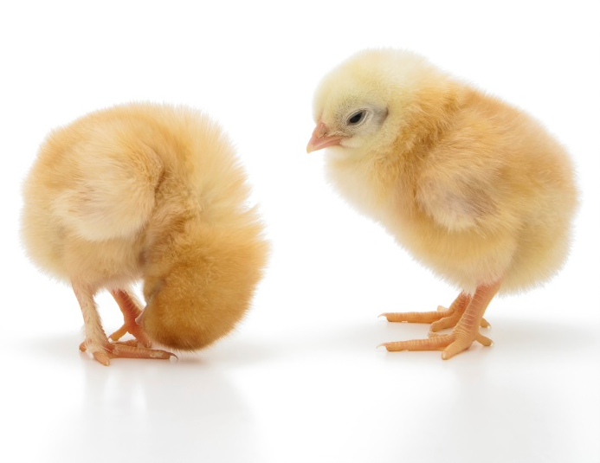
Determining the sex of the domestic chicken (Gallus gallus)
Females and males of sexually dimorphic species can be easily distinguished by differences in their phenotype.
However, many species are sexually monomorphic and cannot easily be distinguished, e.g. many birds and chicks.
?

Slide 6
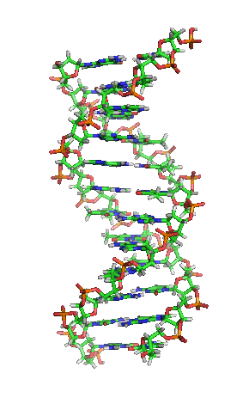
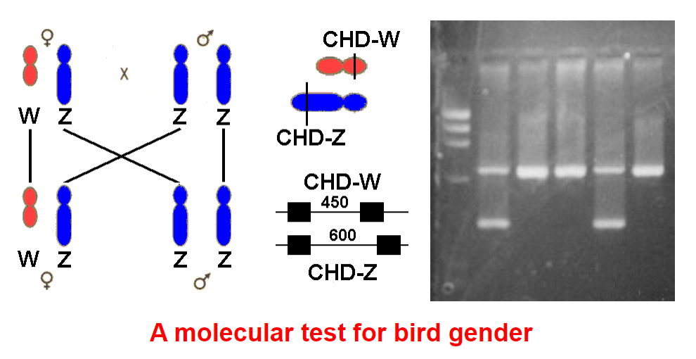
Determining the sex of the domestic chicken (Gallus gallus)
Females and males of sexually dimorphic species can be easily distinguished by differences in their phenotype.
However, many species are sexually monomorphic and cannot easily be distinguished, e.g. many birds and chicks.
Universal genetic markers can be used to reliably sex almost all bird species.
Size/variation of the chromo-helicase-DNA binding gene (CHD1) carried on the sex chromosome
males are homogametic (ZZ chromosomes)
females are heterogametic (WZ chromosomes)
?
Source: SM Carr (2008); mun.ca/biology/scar/Bird_sexing.html

Slide 7
Determining the sex of the domestic chicken (Gallus gallus)
Females and males of sexually dimorphic species can be easily distinguished by differences in their phenotype.
However, many species are sexually monomorphic and cannot easily be distinguished, e.g. many birds and chicks.
Universal genetic markers can be used to reliably sex almost all bird species.
Size/variation of the chromo-helicase-DNA binding gene (CHD1) carried on the sex chromosome
males are homogametic (ZZ chromosomes)
females are heterogametic (WZ chromosomes)
?
Process involves:
DNA extraction
PCR amplification of CHD1 gene
Visualisation of PCR products to determine sex.
Source: SM Carr (2008); mun.ca/biology/scar/Bird_sexing.html

Slide 8
DNA sampling: quality and quantity

Slide 9
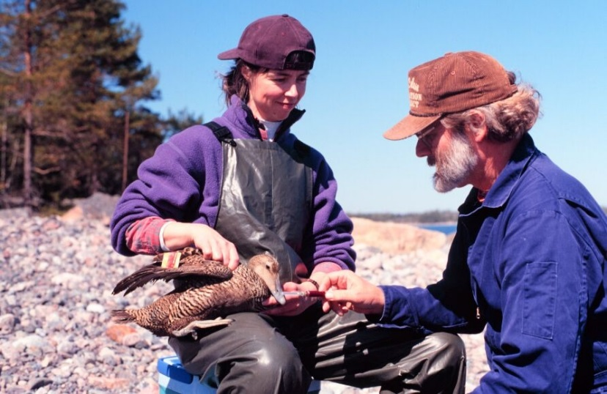
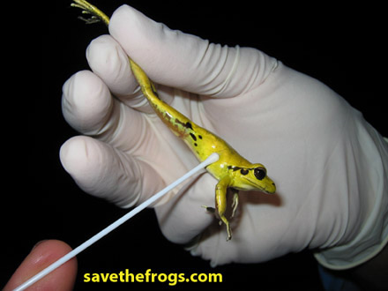
DNA samples
We need to be able to SOURCE DNA from individuals in order to look at their genetics:
Three types of sampling:
Destructive
Non-destructive (invasive)
Non-invasive

Slide 10
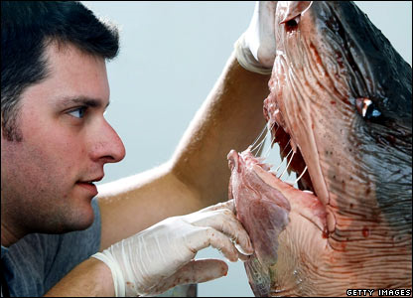
1. Destructive sampling
The animal is killed in order to obtain the tissues necessary for genetic analysis
Necessary in order to obtain enough DNA to do the analysis
e.g. allozyme variation
Small mammals
Reptiles
Birds

Slide 11
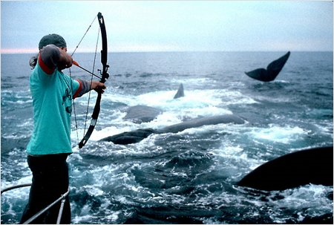
2. Non-destructive sampling or Invasive sampling
The animal is usually captured, and a biopsy or blood sample is taken invasively (small sample)
Some invasive sampling strategies do not require catching the animal
e.g. whales using a biopsy dart gun

Slide 12
3. Non-invasive sampling
Good approach for many species which may be of significance:
conservation concern (e.g. endangered)
cryptic / elusive (e.g. hard to catch)
Source of DNA is left behind and collected without having to catch or disturb the animal

Slide 13
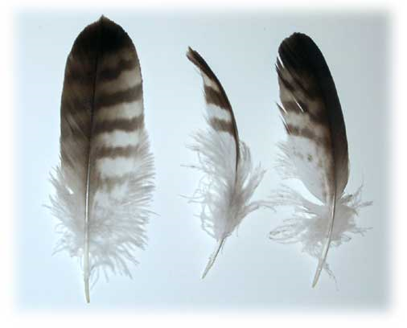
3. Non-invasive sampling
feathers
skins
bones
eggshells
scats
swabs
DNA degrades overtime & may not be reliable for analysis

Slide 14

Which sampling method to use?
Depends what you are doing?
How much DNA do you need?
What quality does it need to be?
Ethical considerations
Replacement, reduction, refinement

Slide 15
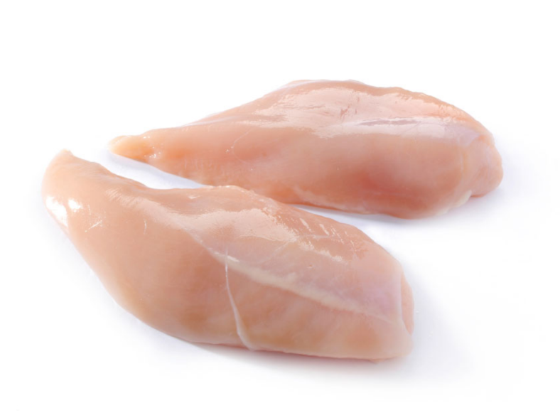
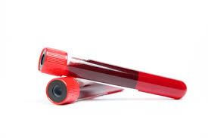
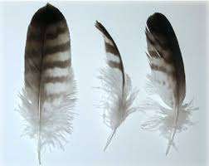
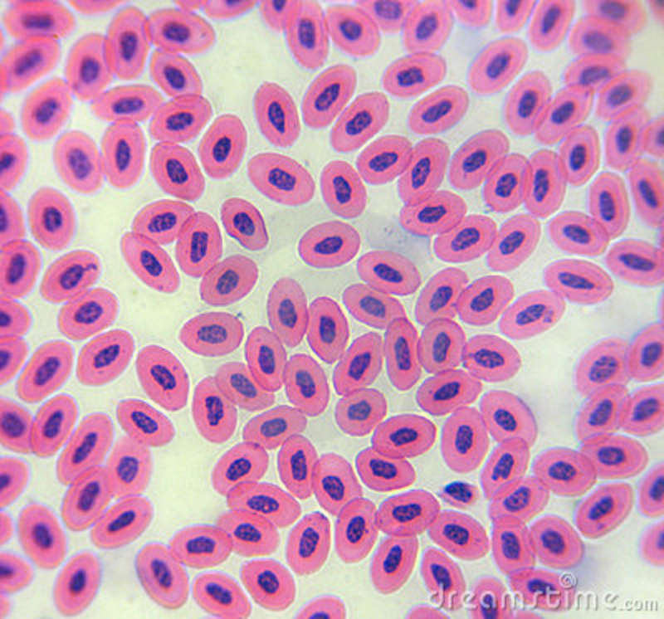
Different sample types and approaches
Muscle
destructive sampling
Blood
Invasive but non- destructive sampling
Feather
Non-invasive/non-destructive
Which do you predict will provide the most DNA? Or the best quality DNA?
What do you notice about this blood smear?
Has this changed your opinion about the above questions?
Chicken blood smear

Slide 16
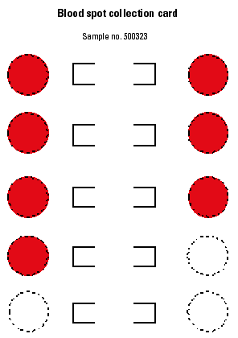
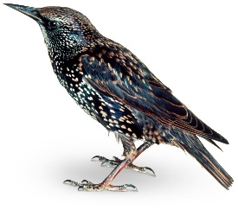
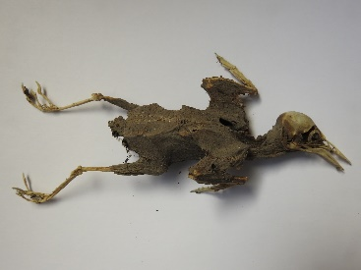
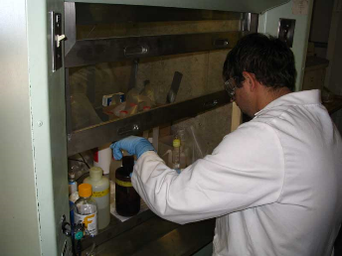
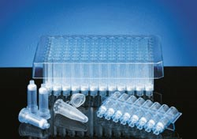
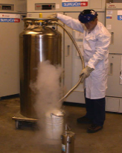
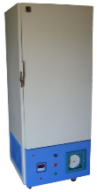
DNA quality
The quality of DNA affected by:
Method of preservation
Stabilisation buffers, ethanol, formalin, blood spot cards
Length of preservation
DNA degrades over time
Method of extraction
Chemical or physical lysis;
in-house or commercial extraction kits
Type & length of storage
Liquid nitrogen, -80°C, -20°C, fridge (4°C), room temperature
Photo: P. Cianfaglione; http://avianmusing.blogspot.com
High stability
(expensive)
Low stability
ideal

Slide 17
How the session will run
You will work together in groups to extract DNA from 3 different sample types.
The DNA samples will be used in subsequent pracs.
Please make sure your tubes are clearly labelled and placed in the appropriate rack/box at the end of the session (your demos will advise you here).
It is important you actively take part in and have an understanding of the procedures as they will support your ability to put together your Assessment task (poster).
Take notes! And think about each sample and the amount of DNA it is likely to yield. Will it influence the downstream PCR assay?
Demonstrators will be available to assist you in answering questions & further guiding you through the activities.
We will use the last 20-30 min of the prac to run through any specific questions

Slide 18
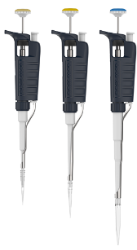
Prac 2 – Part A (Pipetting)
We will go through a quick demo on pipette handling!
(See lab manual pp 20-24)
Complete questions on p 20.

Slide 19

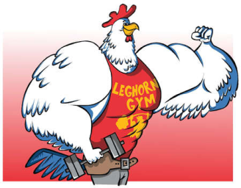
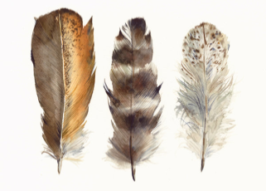
Prac 2 – Part B (DNA extraction)
Reagents | Labelled | Blood (pp 26-28) | Muscle (pp 29-31) | Feather (pp 32-33)
Proteinase K | PK | X | X | X
PBS | PBS_{(B)} | X
RNaseA | RNA_{(M,B)} | x | X
Buffer AL | AL_{(B,M,F)} | X | X | X
Buffer ATL | ALT_{(M,F)} |  | X | X
95% Ethanol | E_{(B,M,F)} | X | X | X
Buffer AW1 | AW1 | X | X | X
Buffer AW2 | AW2 | X | X | X
Buffer AE | AE_{(B,M,F)} | X | X | X

Slide 20
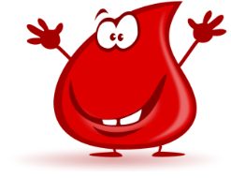
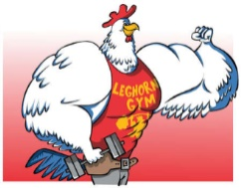
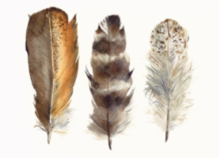
Prac 2 – Part B (DNA extraction)
 | Blood | Muscle | Feather | Reminder
Sample preparation | Blood card - cut 1 hole punch sized | 20mg tissues - About the size of match head | Small section -Refer to pg 34 | Discard razorblade in yellow sharps container
Incubate tube 56˚C for 30 min | Step 7 | Step 3 | Step 3
Change new 2ml collection tube | Step 14 | Step 9 and 10 | Step 7 and 8 | Mark a “C” beside the number
Change 1.5ml microfuge tube | step 16 | Step 12 | Step 10 | Mark a “C” beside the number
While waiting for incubation, 1st record your group name and your sample details to the excel sheet prepared, 2nd try practical 2 questions (p 35). After finishing your extraction bring your samples to us.
Notes:
NOTE: Set up an excel sheet for the students to record sample IDs.

Slide 21
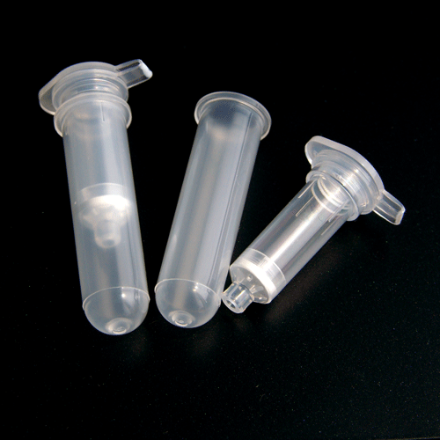
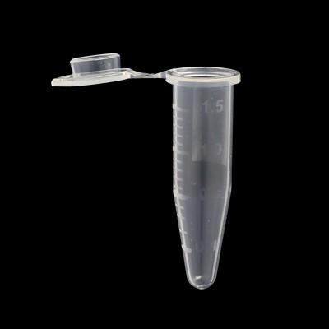
Prac 2 – Part B (DNA extraction)
2ml collection tube
Spin column
1.5 ml Microcentrifuge tube
Spin column + collection tube

Slide 22
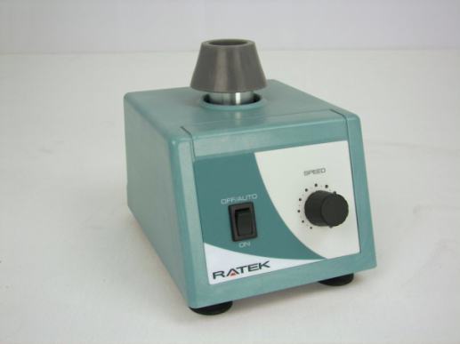
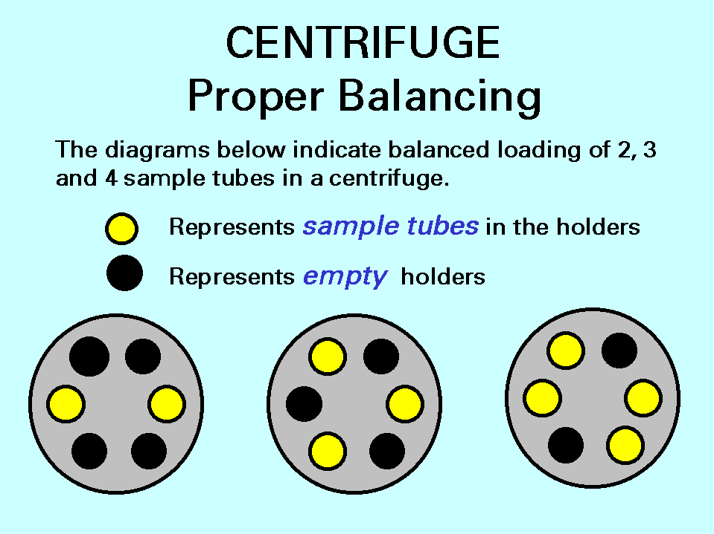
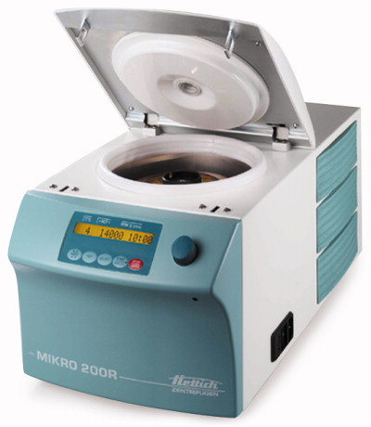
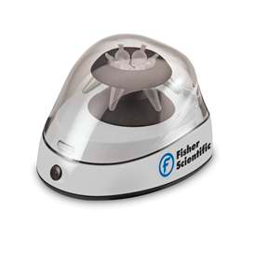
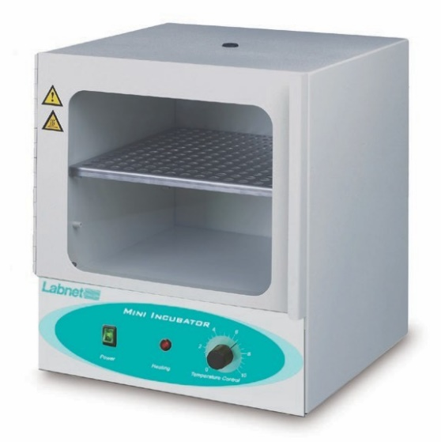
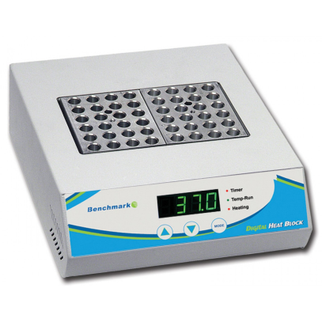
Prac 2 – Part B (DNA extraction)
Vortex mixer
Mini centrifuge
Centrifuge
Always make sure to balance the centrifuge and to cover the lid before centrifugation
Incubator/ Hot plate

Slide 23

Sample labelling
MAKE SURE TO LABEL YOUR TUBES!
Group initials:
John Hotwings & Colonel Sanders = JHCS
Sample type:
B = Blood
F = Feather
M = muscle
For example for a blood sample label = JHCS-B
Notes:
NOTE: this may change depending upon how the prac is set up.

Slide 24
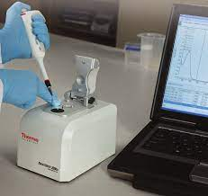
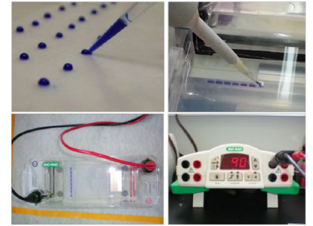
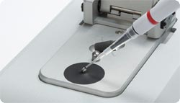
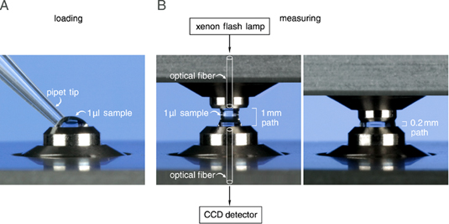
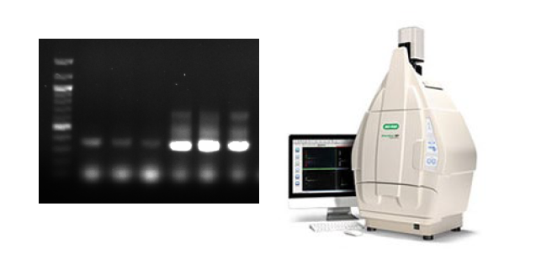
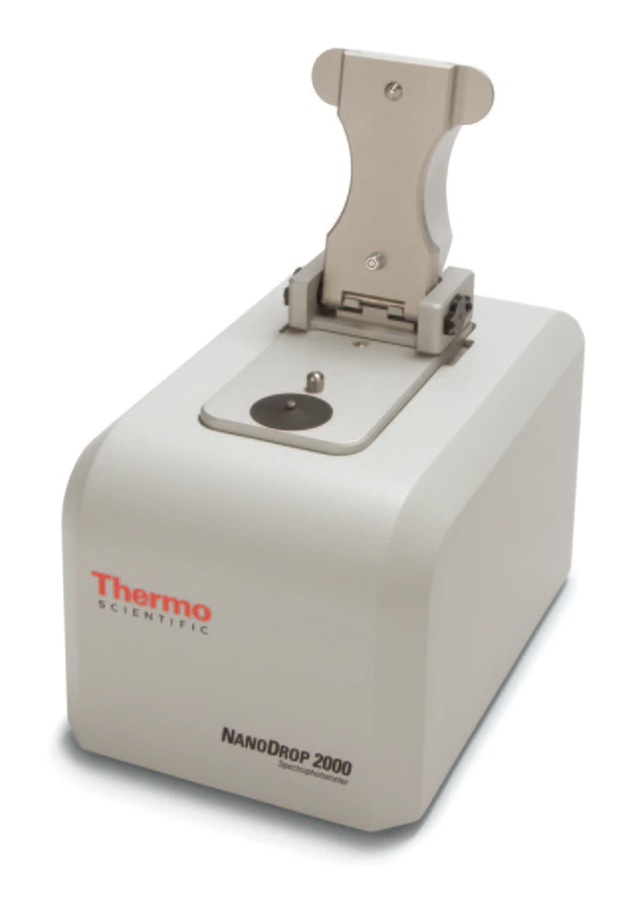
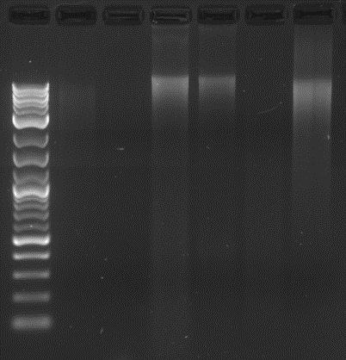
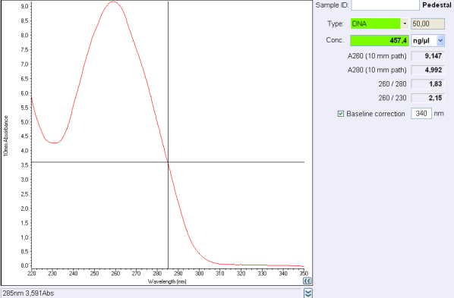
Assessing DNA quality…Week 6 (Prac 3)
Spectrophotometry (NanoDrop)
Gel electrophoresis

